Slide 1


India Food Prices
Sugar Price Forecasting

Slide 2
Business Understanding CRISP–ML(Q) Lifecycle Process
Business Problem
Data Collection & Preparation
Model Selection & Training
Evaluation & Validation
Deployment & Monitoring
Business Understanding
India, one of the largest sugar producers and consumers in the world, experiences significant price fluctuations due to factors such
as seasonality, climate variability, government policies, and market demand.
Policymakers, traders, and businesses require robust predictive tools to stabilize sugar prices,
ensuring affordability for consumers and reducing economic losses for farmers and stakeholders.
This project leverages machine learning techniques to optimize retail sugar price forecasting, enabling more accurate predictions to
enhance decision-making in production, distribution, and market regulation.

Slide 3
Define the Scope of the ML Application
Feasibility
Applicability of ML Technology:
Time-series models such as ARIMA, SARIMA, LSTMs, and STL decomposition + ETS can capture sugar price seasonality and trends.
Legal Constraints:
Compliance with India's consumer protection laws and government sugar pricing policies.
Requirements on the Application:
Build a scalable model capable of handling large datasets of sugar prices across multiple markets.
Develop a user-friendly dashboard for market analysts and policymakers.
Scope | Details
Business Problem . | Optimize sugar price forecasting in Indian markets to ensure stable supply chains and minimize economic volatility.
Business Objectives | -Minimize sugar price volatility across regions. - Improve predictability of sugar market trends. - Help policymakers ensure fair pricing for consumers and farmers. - Optimize supply chain efficiency for sugar production and distribution.
Business Success Criteria | - Improved affordability of sugar for consumers in India. - Increased stability in sugar market prices across states and districts.
ML Success Criteria | - Achieve forecasting accuracy within a ≤10% deviation from actual prices. - Develop robust prediction models that adapt dynamically to sugar price fluctuations.
Economic Success Criteria | - Reduce financial losses caused by sugar price fluctuations. - Improve price forecasting accuracy to support market stability and policy decisions.

Slide 4
Data Collection & Preparation
Data Collection
Data Acquisition:
Source sugar price data from https://data.humdata.org/dataset/global-wfp-food-prices
Extract only retail sugar price records from the India dataset (CSV format).(India - Food Prices | Humanitarian Dataset | HDX)
Data Version Control:
Use Git (version control tool) or cloud solution like AWS for data storage and to track changes to the dataset.
Data Quality Verification
Data Description:
Ensure correct formatting of:
Date: Standardized datetime format.
State, District, Market: Validate geographical consistency.
Price: Standardize all prices in INR per kg for uniformity.
Data Requirements:
Complete records for sugar prices, market locations, and price categories.
Remove duplicate entries and inconsistencies.
Data Verification:
Detect and handle missing values or unrealistic sugar price spikes/outliers using automated data checks.

Slide 5
Data Collection & Preparation
Data Preparation | Details
Feature Selection | - Extract relevant features like date, state, market, price category, and price per kg. - Use correlation analysis to identify key price-influencing factors.
Data Selection | - Focus on sugar price trends from 1994 to 2025 - Analyze regional price variations across states and markets.
Unbalanced Classes | - If certain regions have fewer price records, use interpolation techniques to fill gaps.
Noise Reduction | - Remove irrelevant columns or inconsistent records. - Smooth extreme price fluctuations using moving averages.
Data Imputation | - Fill missing price values using mean, median, or predictive models (e.g., KNN imputer).
Feature Engineering | - Extract seasonality indicators like month, quarter, and year. - Adjust prices for inflation using Consumer Price Index (CPI). - Calculate price volatility using rolling standard deviations.
Data Augmentation | - Generate synthetic sugar price data for regions with sparse records using time-series models (ARIMA, SARIMA). - Incorporate external factors like rainfall, festival periods, or government sugar policies to refine predictions.

Slide 6
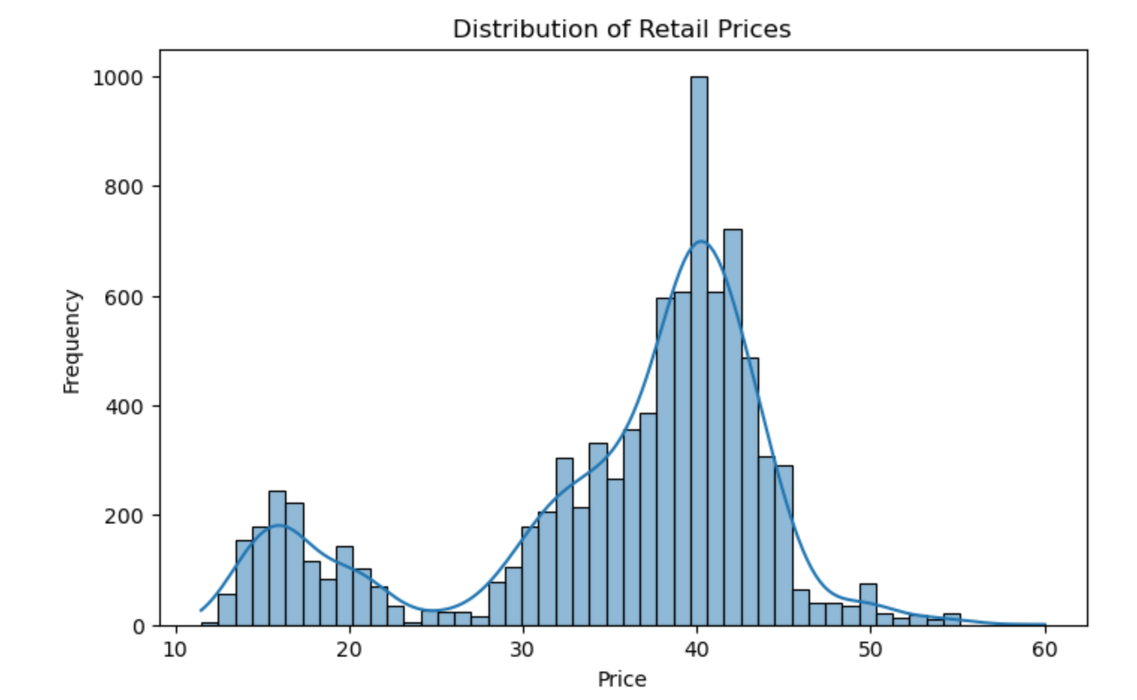
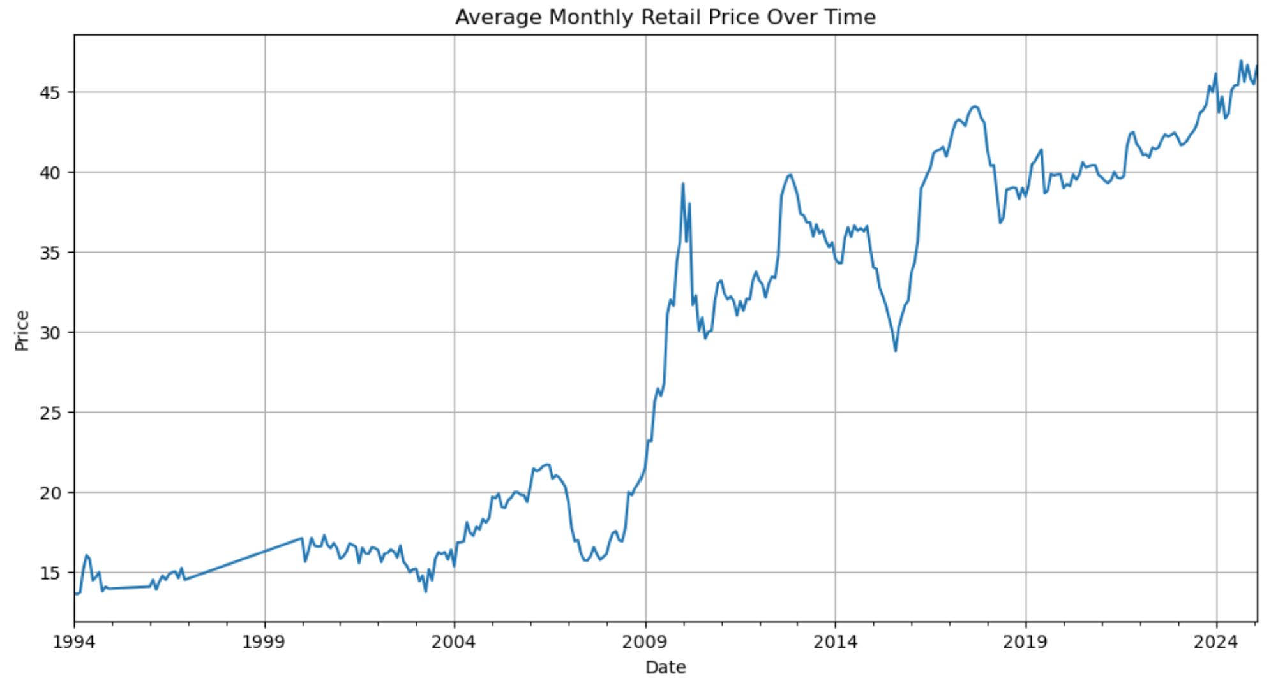
Initial Data Exploration
Dataset Overview
The dataset consists of historical sugar price records across different regions in India, with timestamps that allow for time-series analysis.
The key attributes include:
Date: The time period of recorded sugar prices which ranges from 1994 to 2025.
Price: The actual recorded retail price of sugar in INR.
Price Type: Categorization of price type (Retail, Wholesale, etc.), from which we filtered only retail prices for focused analysis.
Key Visualizations and Insights
Distribution of Retail Sugar Prices
A histogram of retail sugar prices reveals the overall price distribution, helping us understand price concentration and possible outliers. This distribution provides insights into price stability and volatility over time.The distribution of retail prices is bimodal, with peaks around $15-$20 and $35-$40, suggesting two distinct pricing segments in the market.
Time-Series Analysis of Monthly Average Prices
By aggregating sugar prices on a monthly basis, we observe long-term trends and seasonal fluctuations. This time-series analysis helps identify patterns such as peak price seasons and price drops, which can be critical for forecasting future price movements. The average retail price shows a long-term upward trend with significant spikes around 2008 and post-2018, indicating market fluctuations and economic influences.

Slide 7
Model Selection & Training
Steps | Details
1. Literature Research on Similar Problems | Study past research on sugar price forecasting using time-series models and ML techniques. Identify best practices for dealing with highly volatile agricultural commodity prices.
2. Define Quality Measures of the Model | Performance Metrics: Root Mean Squared Error (RMSE) – Measures prediction accuracy. Mean Absolute Percentage Error (MAPE) – Evaluates forecast reliability. Mean Absolute Scaled Error (MASE) – Compares against baseline models. Robustness: Validate model performance under extreme price shocks. Scalability: Ensure model efficiency for large-scale price data.
3. Model Selection | Compare Models: Naïve Baseline Model (for benchmarking). - Seasonal Naïve Model (captures yearly seasonality). - STL Decomposition + ETS (captures trend and seasonality). - ARIMA & SARIMA (statistical time-series forecasting). - LSTM & Deep Learning Models (for complex pattern recognition).
4. Incorporate Domain Knowledge | Market Behavior: Account for government sugar subsidies, export policies, and seasonal harvesting periods. External Data Sources: Integrate rainfall data, inflation rates, and festival season trends affecting sugar demand.
5. Model Training | Data Split: Train (80%) – Test (20%) with k-fold cross-validation maintaining temporal order to prevent data leakage and ensure robustness in time-series forecasting. Hyperparameter Tuning:- Use grid search and Bayesian optimization to enhance model accuracy.

Slide 8
Evaluation & Validation
This phase ensures the machine learning model is reliable and meets predefined goals.
1.Validate Performance
Compare model predictions against actual sugar prices in case of long-term and short-term forecasting
Long Term Forecasting – 12 months
Short Term Forecasting – Up to 6 months
2. Determine Robustness
Test models against data anomalies and missing values.
3. Explainability
Aim to find a balance between achieving high model accuracy and ensuring the model remains interpretable.
4. Compare Against Success Criteria
Ensure forecasting accuracy meets the business objective (<10% error).

Slide 9
Deployment & Monitoring
1.Deployment Strategy
Deploy via API/web dashboard for easy access by stakeholders.
Implement real-time forecasting updates.
2. Model Maintenance
Monitor price data drift to detect non-stationary price behavior.
Schedule model retraining as new price data becomes available.
3. Error Handling & Risk Management
Automate alerts for sudden price surges.
Provide alternative predictions in case of data disruptions.
Conclusion
This project focuses on retail sugar price forecasting to help stabilize market fluctuations, support government policy decisions, and optimize supply chains.
We would explore Machine learning models like SARIMA, STL+ETS, and LSTMs to offer accurate price predictions, contributing to better price stability and affordability for consumers and businesses.

Slide 10
Thank You

